Slide 1
Notes from Ebeye
30 August 2023
Eric Rasmussen, MD, MDM, FACP
Kwajalein Atoll, July 2019
Photo by Lorenzo Moscia

Slide 2
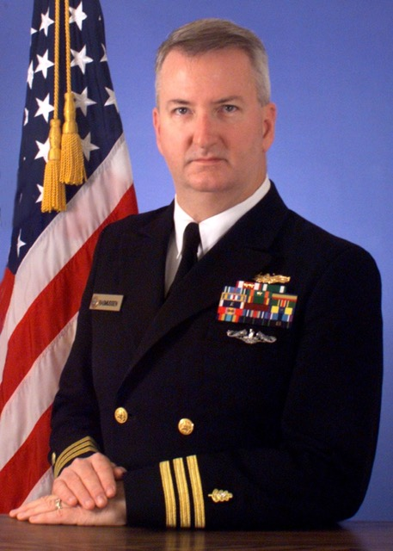
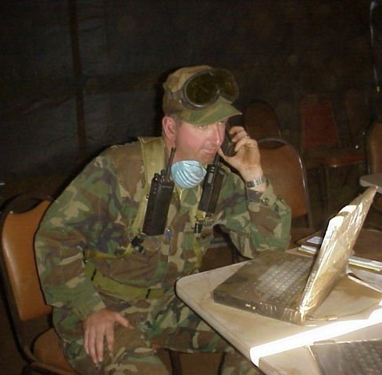
A US Navy doctor for 25 years

Slide 3
The Future
Between 1900 - 2020
The economy of the Marshall Islands is already losing an average of 7.4% of GDP annually to global warming*
* https://foreignpolicy.com/2022/08/01/climate-change-pacific-islands-security

Slide 4
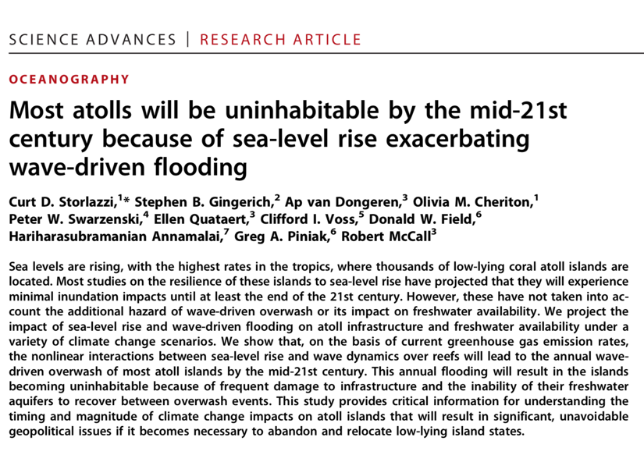

Slide 5
KASL
Purpose: To discover the climate adaptation ideas percolating somewhere that might help the Marshallese:
Live better now,
Transition more gently,
Be more welcome as future Climate Navigators
- The Marshallese are living in the future. All of humanity will soon face these challenges. - The Marshallese will gain adaptation skills first, then teach everyone else.

Slide 6
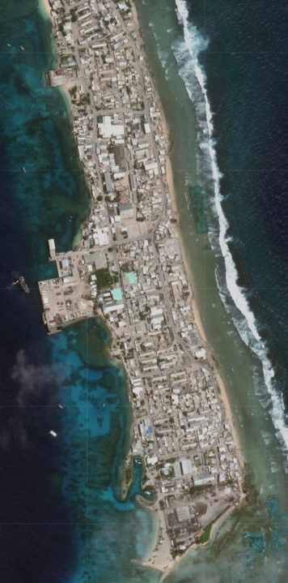
Remembering 2019…
Coastal Community Human Security Survey
( CCHSS )
Ebeye had never had addresses for homes.
Ebeye had never known how many people live there.
Ebeye had never had a survey of its eroding reef edge.
Ebeye had not been able to track sea level rise.

Slide 7
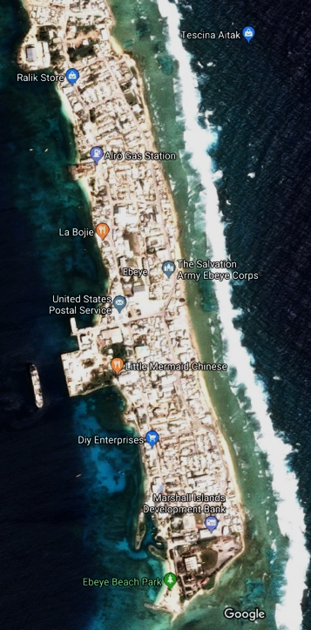
Old
New
First step:
Get a better look at the island.
In early July 2019, at our request, Google Earth released a new 30cm resolution view of Ebeye.

Slide 8
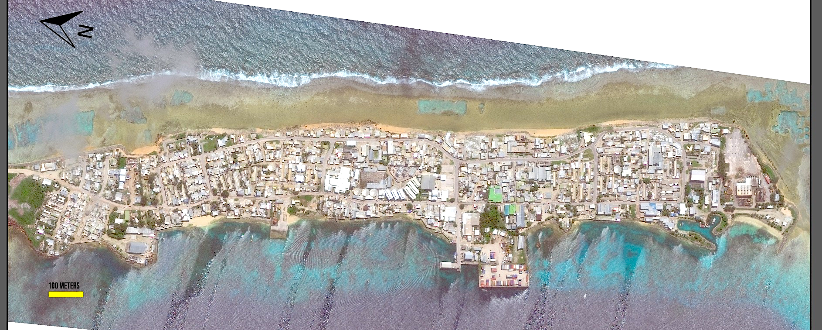
Ebeye, 22 August 2022
10-centimeter resolution.
Poster 4 feet by 3 feet.

Slide 9
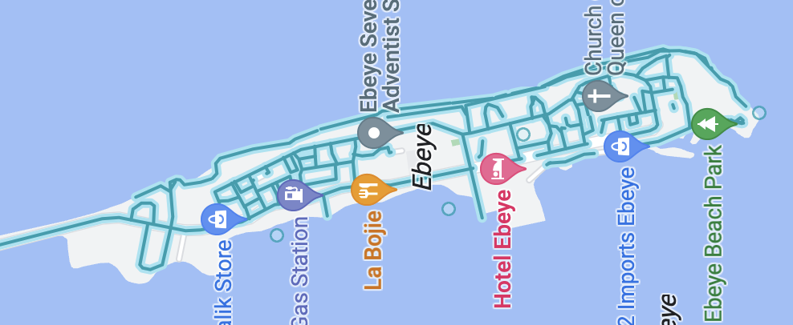
Then, a two-phase Streetview mapping.
Pacific ALLIES

Slide 10
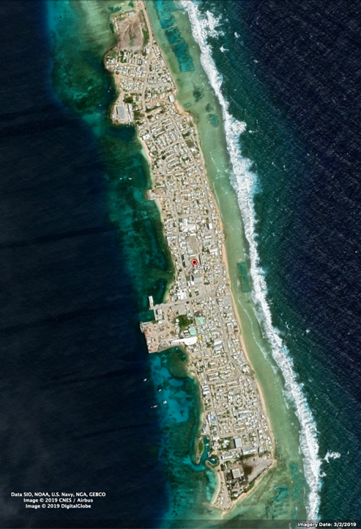
Second phase: Island demographics
Part 1 of 2:
Determine the W3W address and save it to the form.
Ask three questions about people who live there:
How many people sleep here?
How many of them are under age 18?
How many are US military veterans?

Slide 11
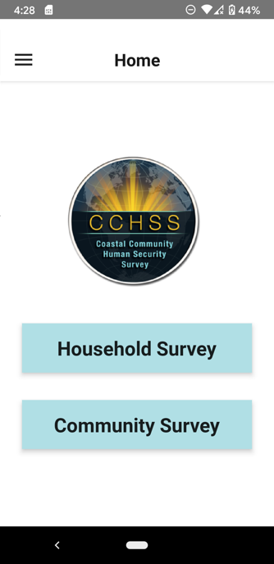
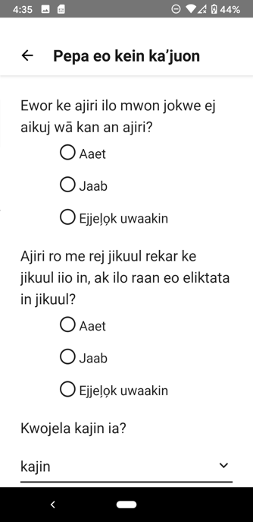
CCHSS app
Revised based on field testing and completed. Language localization expanded. Enhanced What3Words integration.
Packaged on GitHub and released to ONR.
===
Note:
Poor cell and wifi meant challenging GPS resolution on Ebeye, even with decent phones chosen for the purpose.
New capability: W3W is now usable completely offline. No cell needed, no wifi needed. Just a view of the sky.

Slide 12
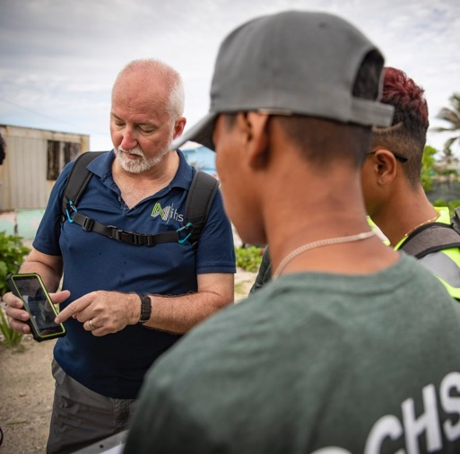
Part 2 of 2: The Needs Survey
Do you have clean drinking water in this home today?
Do you have enough food for today?
Do you have a toilet available to you in this home today?
Will you have any light here after the sun goes down tonight?
Do you have a working phone available to you today?
Does anyone living here receive income from work?
What languages do you understand? (and we have a list)
In the past ten years, has anyone:
Who slept in this home moved to the United States?
Moved from another RMI island into this home?
Is anyone here sick today?
Is anyone here injured?
Do any children here need vaccinations?
Do any children here need glasses or dental care?
Were the school-aged children in school on the most recent school day?

Slide 13
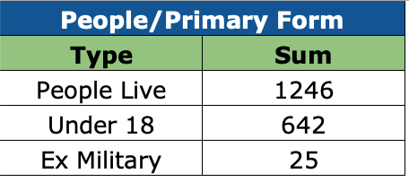
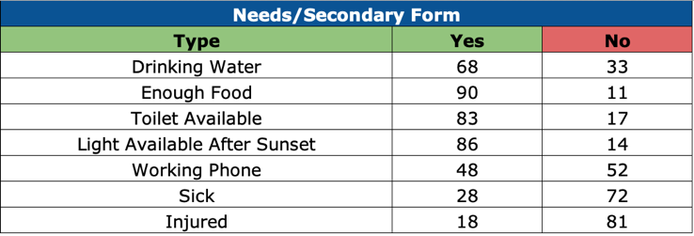
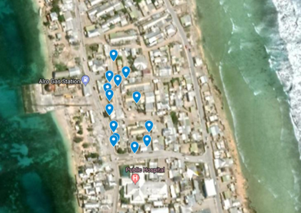
Representative data, Central Section, Household Survey…
A quarter of all households had unreported ill or injured.
A third of households had no access to clean drinking water.
One household had 42 people living in it.
That exceeded KALGOV’s max guess.

Slide 14
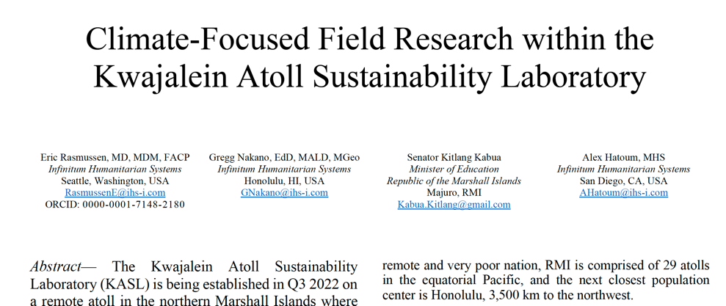

Slide 15
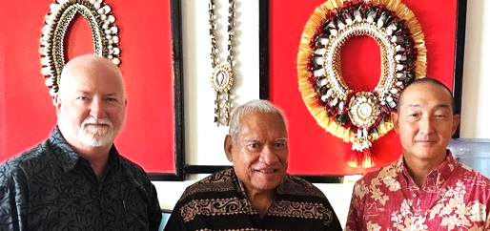
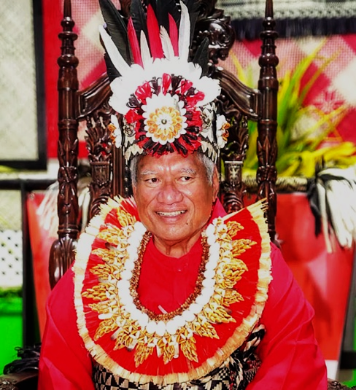
Iroojlaplap (and elected Senator) Michael Kabua, Paramount Chief of the Kwajalein Atoll peoples, has offered his support for anything KASL can do to help the Marshallese.
25 February 2023
Coronation
21 July 2022

Slide 16
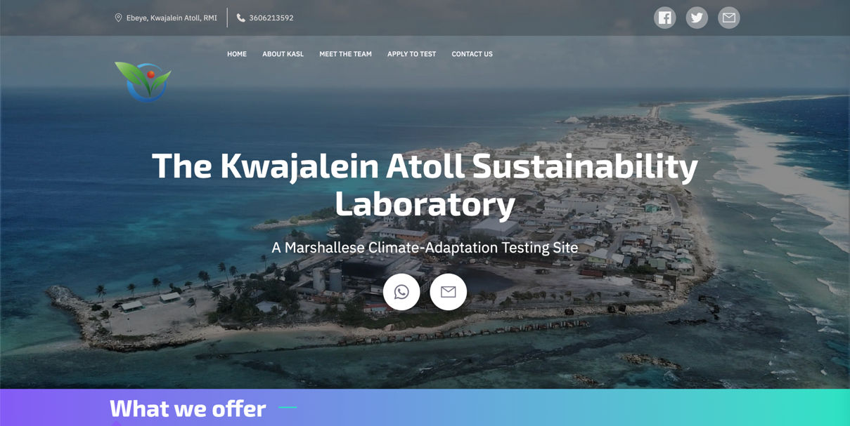
www.KASL.earth

Slide 17
Cultural preservation
Energy
Water
Healthcare
Education
Food
Shelter
Sanitation
Communications
Transportation
Job creation
Ecosystem Regeneration
Research
Sectors

Slide 18
Risks & Opportunities
Risks for the KASL concept
No one cares
No one tests
No one evaluates
Nothing proves useful
Nothing proves affordable
Nothing proves acceptable
We annoy, frustrate, disappoint, or humiliate the local population
We prove inadequate at our task, so future opportunities for vulnerable populations are lost.
China gains a greater foothold.
Opportunities
New testing venue
New evaluation processes
New climate strategies
New engineering at scale
Water and food security improve
Health metrics improve
Education expands
Jobs are generated
Economies enlarge
Choices develop
China, a peer-competitor, becomes less so.

Slide 19
KASL Project Proposals
26 August 2023

Slide 20
From seawater, to Ebeye RO desalination, to a waste brine stream, to cement:
Water
Desalination brine
455,000 gpd of brine
60x the concentration of seawater
Magnesium hydroxide (MgOH)
Magnesium Oxide (MgO₂)
Brine outflow
Partial brine electrolysis
Heat
(630°C)
Chlorine gas (Cl₂)
Hydrogen gas
(H₂)
Sodium hydroxide
(NaOH)
low-molarity
Magnesium Chloride (MgCl)
Magnesium Oxychloride Cement
(Sorel Cement)
Hydrochloric acid
(HCl)
Results:
From salt-water desalination brine and electricity, we can make magnesium cement as
a building material at a rate of ~800 tons per year with the current desalination on Ebeye.
From woody byproducts such as coconut husk, we can generate electricity, heat, and ash.
Solar power can provide the rest of the required electricity.
Particulates captured from burning wood are used to enhance the capabilities of the magnesium cement.
Ash from burning can provide fertilizer for growing food plants.
All of these technologies together provide a chain of products that result in a 100% local production of a construction material that can be used on the islands or exported.
Wood ash
from burned coconut coir
Ebeye Saline Cement
(Kenney Cement)
Notes:
It all starts to fall together when you consider the following steps:
Concentrated brine is available from the salt water desalination plant on Ebey at a rate of 455000 gallons per day http://kajur.net/learning-centre/how-does-ro-work/
The brine density from RO desalination is roughly 60x that of the seawater itself.
PNNL/UW have developed a low cost method to extract Mg(OH)2 (Magnesium Hydoxide) precipitate from brine using a co-flow of low molarity Sodium Hydroxide.
Electrolysis of seawater generates chlorine gas, hydrogen gas, and a low molarity solution of highly refined Sodium Hydroxide.
Magnesium Oxide is refined from MgOH by heating to 630c with distilled water as the byproduct. MO2 is the primary ingredient in magnesium cements.
HCl acid can be generated by combining the electrolysis byproducts (Cl2 and H2 gases).
Combining HCl with MgOH creates Magnesium Chloride (MgCl.)
MgCl is the second ingredient in Magnesium Oxychloride Cement (Sorel Cement)
Sorel Cement is an excellent cement, much stronger than portland cement, but does degrade in contact with water without additives.
Efficient burning of woody agricultural byproducts (coconut shell, etc.) produces wood fly ash and heavier wood bottom ash. https://airburners.com/products/pg-firebox/pgf-100/
The heavier wood bottom ash is a good agricultural fertilizer.
Wood fly ash works like coal fly ash as an additive to cement that increases its water and weather resistance.
Conclusions:
From salt water desalination brine and electricity, we can make magnesium cement as a building material at a rate of ~800 tons per year with the current desalination on Ebey.
From woody byproducts such as coconut husk, we can generate electricity, heat, and ash.
Solar power can provide the rest of the required electricity.
Particulate captured from burning wood is used to increase the capabilities of the magnesium cement.
Ash from burning can provide fertilizer for growing food plants.
All of these technologies combined together provide a chain of products that result in a 100% local production of a construction material that can be used on the islands or exported.
Future steps:
Creating uses for magnesium cement - Housing, floating platforms, etc.
Thoughts for today.....

Slide 21
From seashells and coconut waste to durable lime cement
Products
BioChar
(Charcoal)
Fertilizer
Mollusk Shells
(Seashell and Snail Shell)
Water Purification
Turbine
Generator
Coconut Husk
Biochar Reactor
3148 tons per year current production in Marshall Islands
Waste Heat
Heat Exchanger
Electricity
Seashell
Lime Kiln
CaCO₃  CaO + CO₂
(Calcium Carbonate) (Calcium oxide)
Distilled Water
Wood Gas
Crushed Coconut Shell
Mechanical Mixer
CaO + H₂O  Ca(OH)₂
(Calcium Oxide) (Calcium Hydroxide)
Food Preservative
(Pickling Lime)
Water
Calcium Hydroxide
Anti-Fungal
(Dusting Powder)
Quicklime
Agricultural Anti-Fungal
(Dusting Powder)
Results:
Coconut husk is a woody byproduct from copra production
Seashells are a byproduct from food harvesting
Burning coconut husk in a biochar reactor creates charcoal and ash
Volatile wood gases from biochar are burned in a secondary lime kiln
Seashells heated to 850°C convert to calcium oxide (quicklime)
Calcium oxide mixed with water creates calcium hydroxide (slaked lime)
Calcium hydroxide, crushed coconut husk, sand, ash and water make “Roman” lime cement
Byproducts have many uses: Electricity, water purification, fertilizer, food preservative, etc.
Powdered Ash
“Roman” Lime Cement
Water
Sand
Atmospheric CO₂

Slide 22
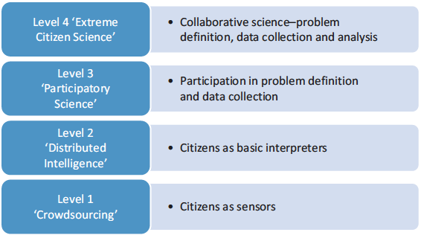

Slide 24
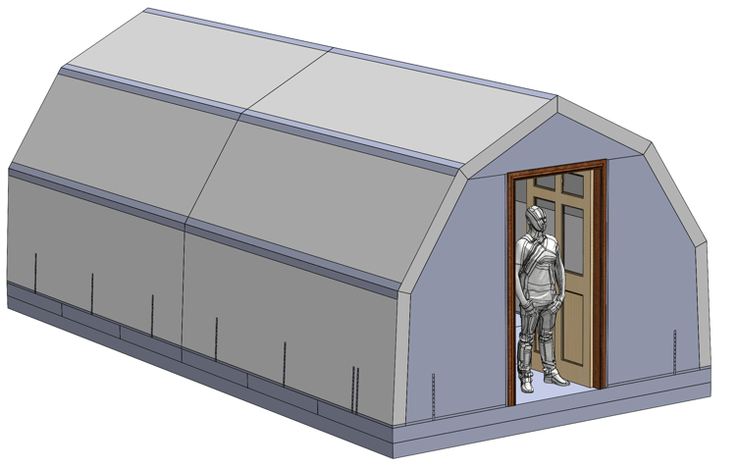
Ukrainian Swallow’s Nest (Ластівчине Гніздо) Simple, Insulated, Robust, Cheap, and Secure Shelter - Community-built for displaced families - Mother and two teenagers can build in a week
Design and construction by Dan Kenney

Slide 25
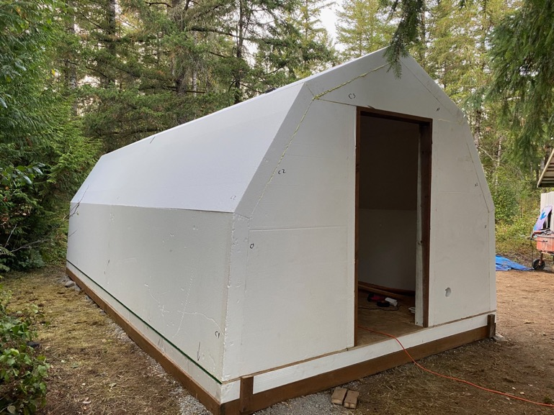
Swallow’s Nest
October demo near Seattle
Complete success.
And under budget.

Slide 26
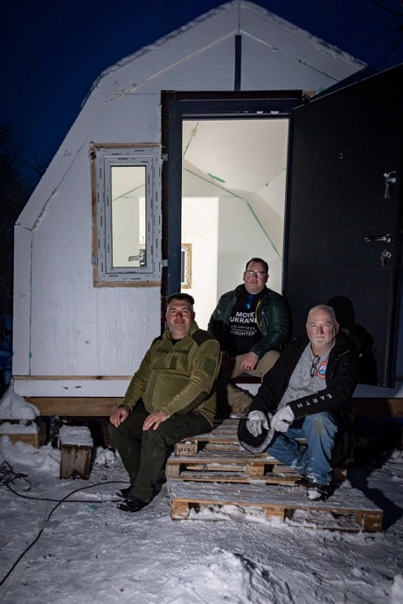
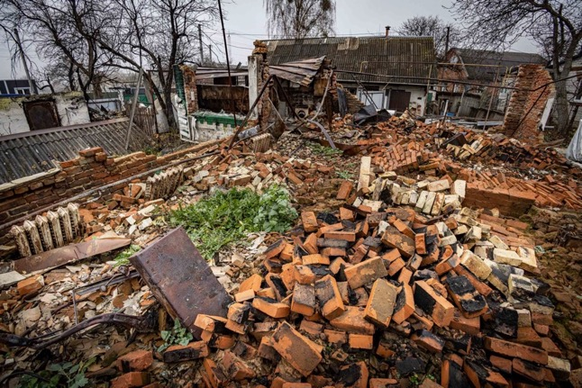
Swallow’s Nest
Makariv, Ukraine
Warmed by the equivalent of a hair dryer.

Slide 27
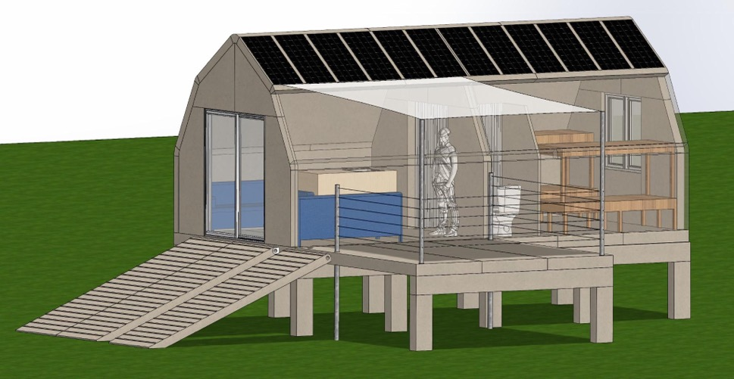
KASL Nest – same hand-assembly as in Ukraine
Climate Security Research Station
Ebadon Island, Kwajalein Atoll, RMI

Slide 28
KASL Nest – sensor suite design (team in September)
Environmental Sensors
Weather station (temperature, wind, rain, barometric pressure, humidity, UV intensity, visible light)
Air quality particulate sensor (P_{2.5})
Radiation sensor (atmospheric ionization)
CO₂ sensor
Hydroponics sensors
Soil Moisture
Soil pH
Ground Water sensors
Ground water level (aquifer level)
water salinity/conductivity
Biorock reef sensors
Placed at 3-5 meters depth
Measures wave height versus average water column above sensor
Ocean pH close to biorock structure
Ocean pH away from biorock structure
Salinity
Low-light camera (1-12 photos per day)
Data Availability
Solid state hard drive connected to Sumi or Raspberry Pi as Network Storage, containing data resources that can be downloaded:
Entirety of Wikipedia
USDA handbooks
User manuals for all equipment
Opensource Literature Library
Project Gutenberg
Khan Academy
Maps, LIDAR, and bathymetry data (2023)
Accessed via WiFi hotspot

Slide 29
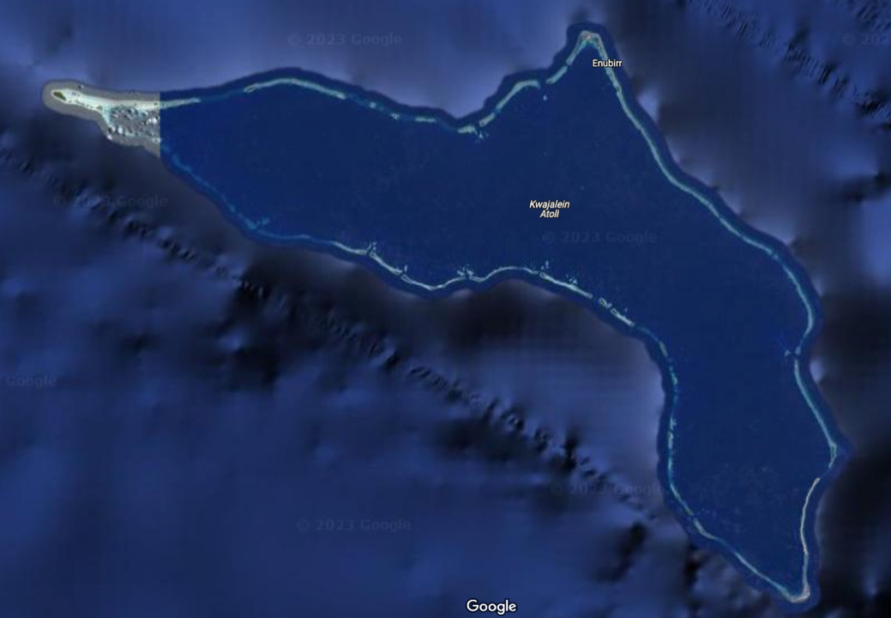
Ebadon
Ebeye

Slide 30
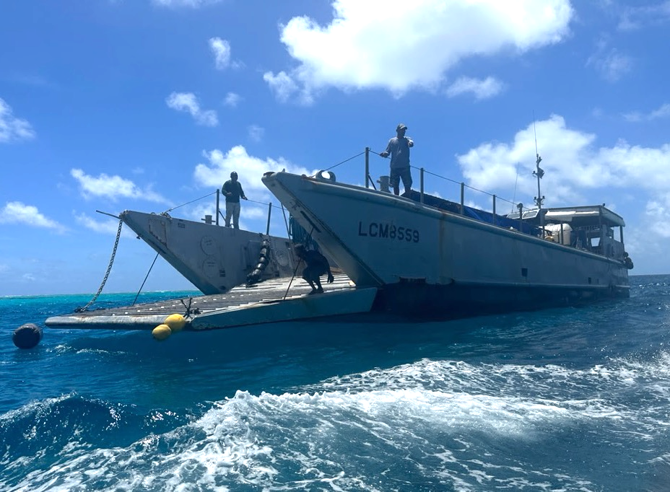
Transitioning off Mejjato Island, preparing transport by panga over the reef flats.

Slide 31
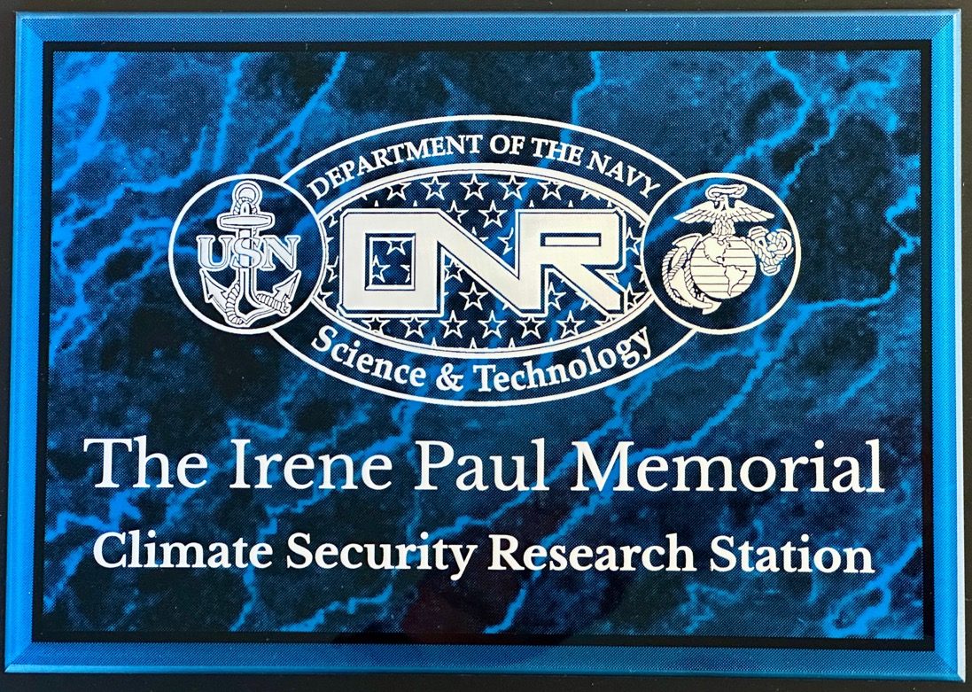
Plaque for the interior workspace.
Irojlaplap Michael M. Kabua donated the land for the station to the Kwajalein government in the name of a remarkable indigenous woman, Irene Paul.
She died two months after his gift, and the Marshallese Council later voted on the name assignment.
The KASL team installed this plaque at a christening ceremony during July 2023.

Slide 32
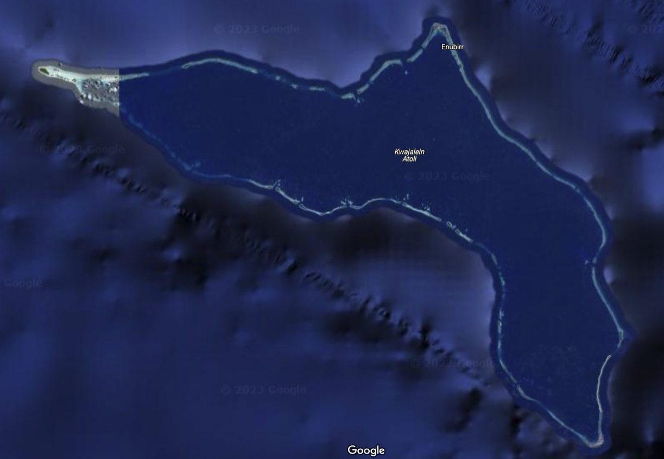
KASL is located on Ebeye. The Climate Security Research Station is on Ebadon.
Ebadon
Ebeye

Slide 33
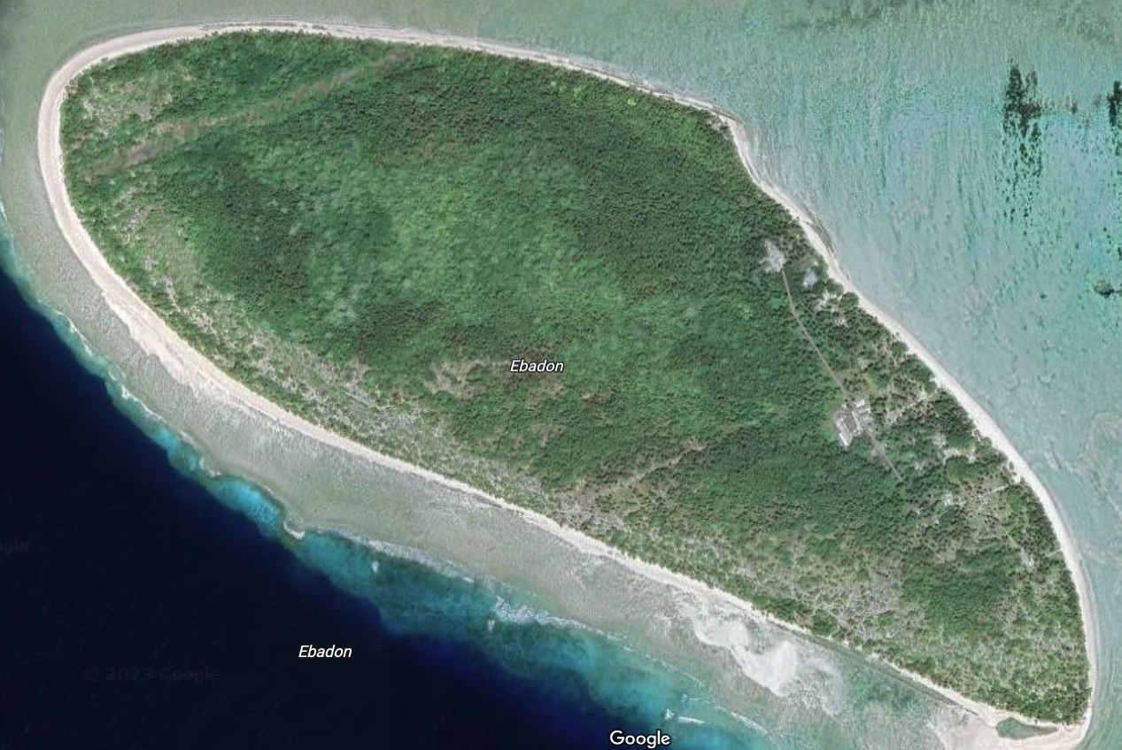
Housing compound
Panga offload site
Build site
Ebadon School
K-8

Slide 34
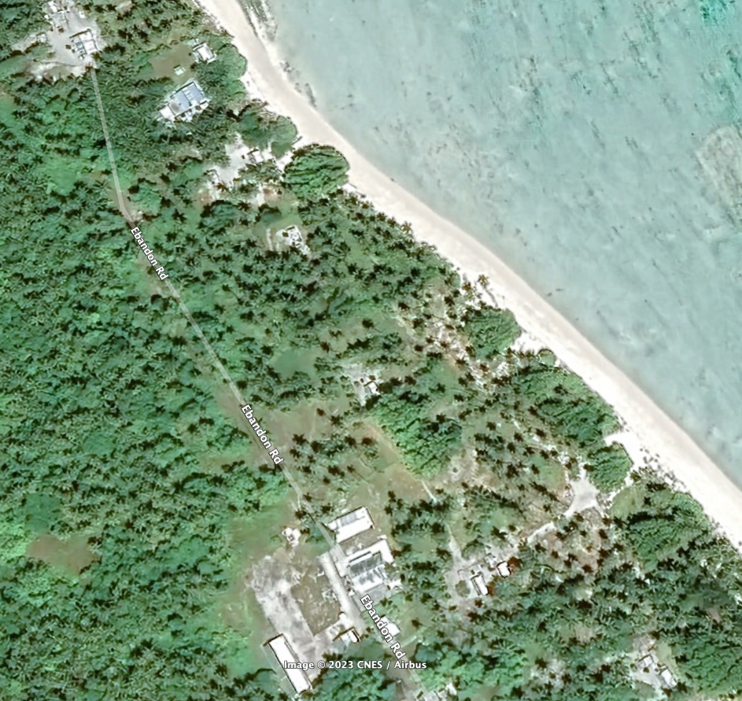
Housing compound
Build site
Ebadon School
K-8

Slide 35
There are no tourists on Ebadon. Total population is less than 90.
This hammock was my home during the building of the Research Station.

Slide 36
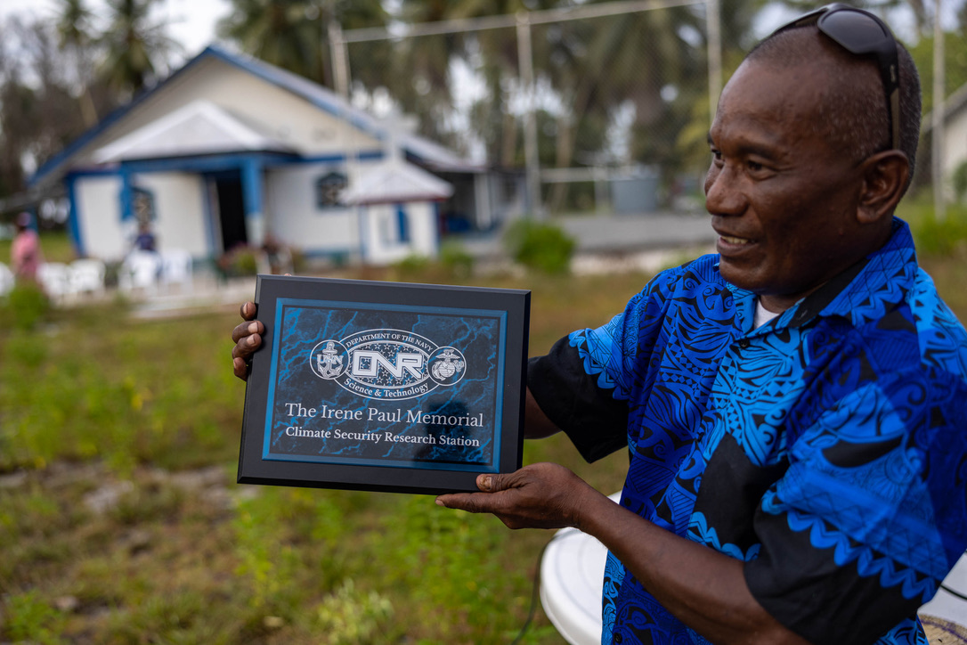

Slide 37
The groundbreaking on Ebadon, 09 July 2023.

Slide 38
May we have a video, please?

Slide 39
The governments of Hawaii County and Kwajalein Atoll, and Ebeye and Hilo, agree that Sister Cities and Counties should exchange Best Practices around climate adaptation.
So, we’re developing an idea we call…
Resilient Sisters

Slide 40
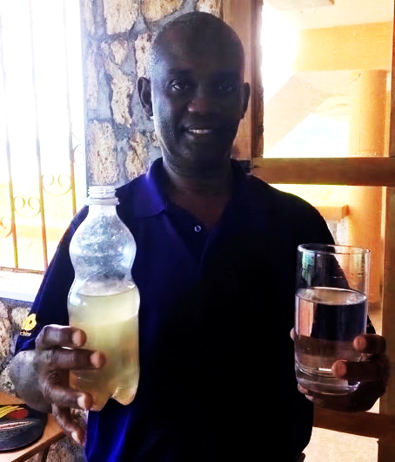
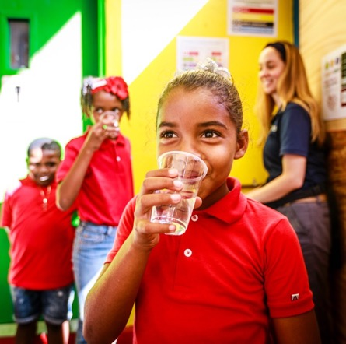
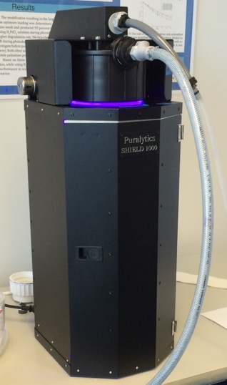
Clean Water: September 2017
800 gallons / 24 h
using only 950 watts.

Slide 41
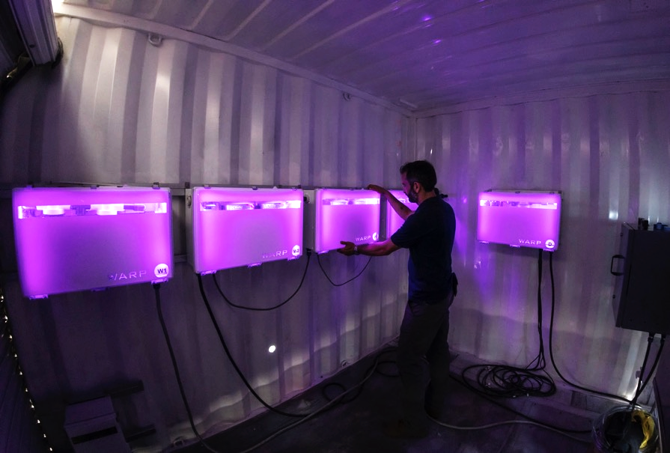
Better Clean Water: To be installed on Ebeye September 2023
3,200 gallons / 24 h
using 300 watts.
4x more water
1/3rd the power
2/3^{rds} the cost
Better purification
Modular
More robust
Fewer parts
Many sensors

Slide 42
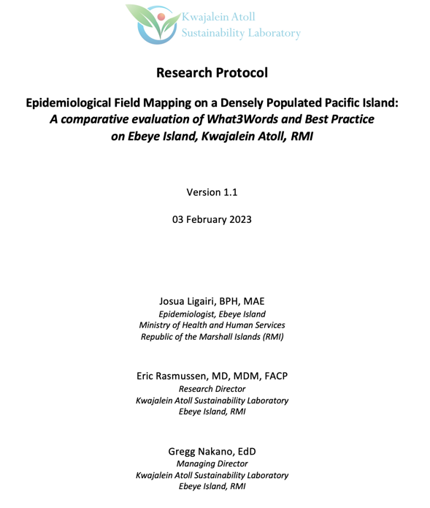
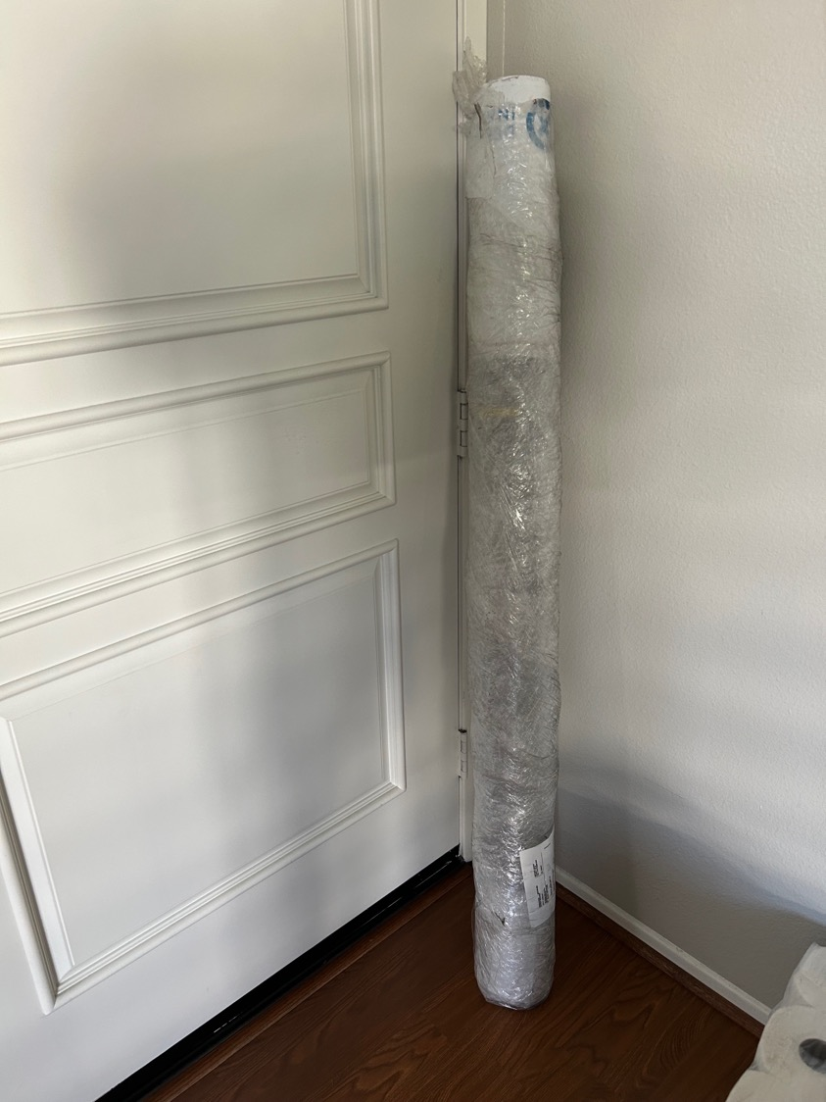

Slide 44
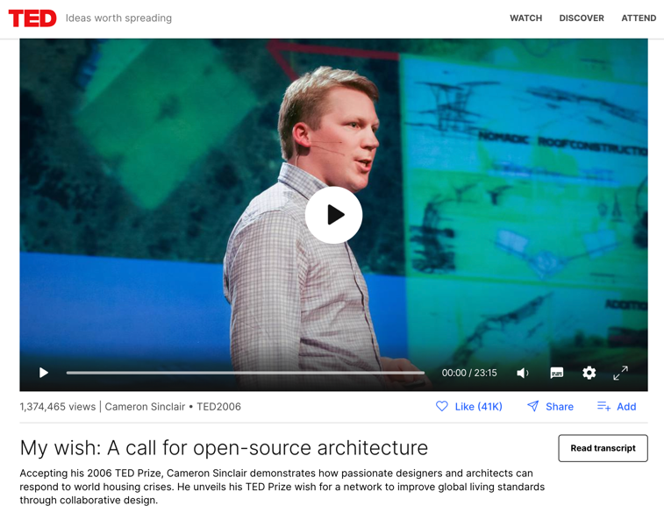
Architect Cameron Sinclair, winner of the 2006 TED Prize for “Design Like You Give A Damn”, has offered to conduct a global climate-resilient housing competition for the Marshall Islands.

Slide 45
We need to pay more attention to dental care.

Slide 46
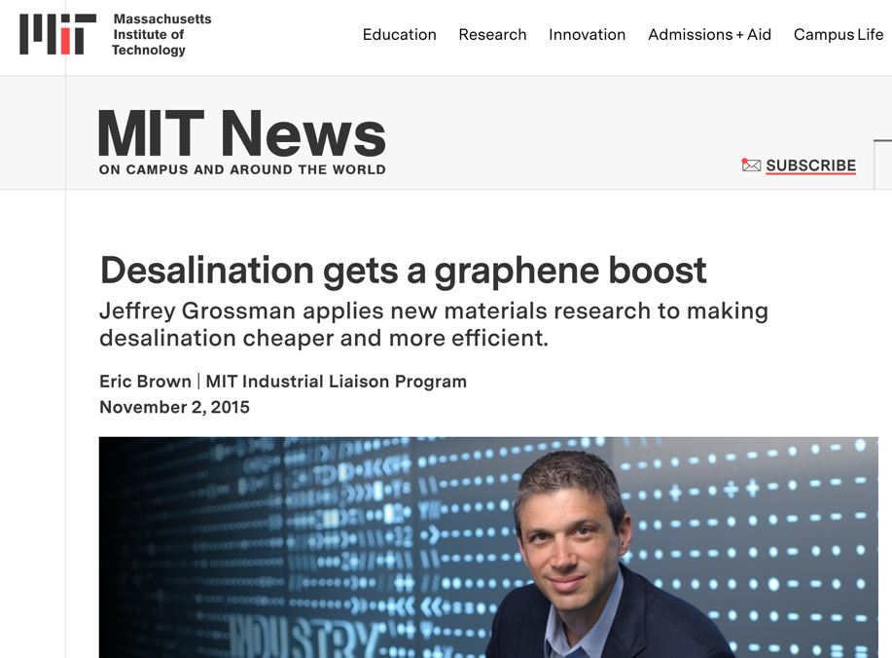

Slide 48
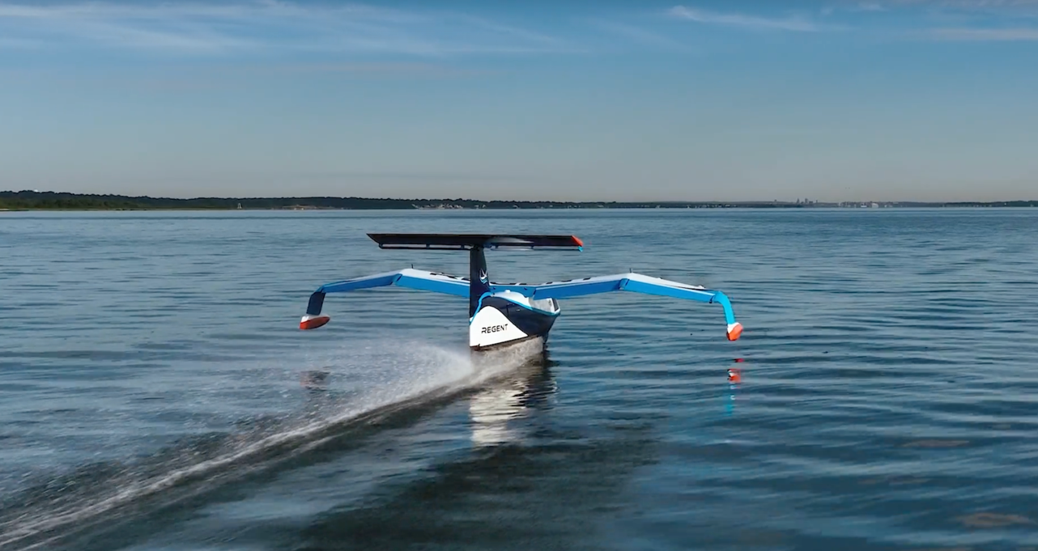

Slide 49
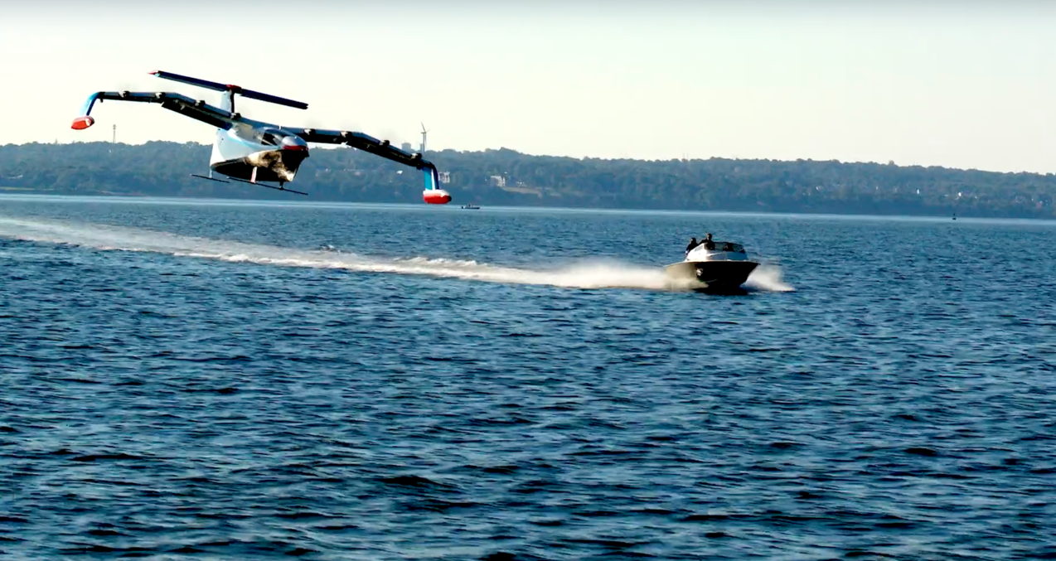

Slide 50
Thanks for taking the time to think about this.

