Slide 1
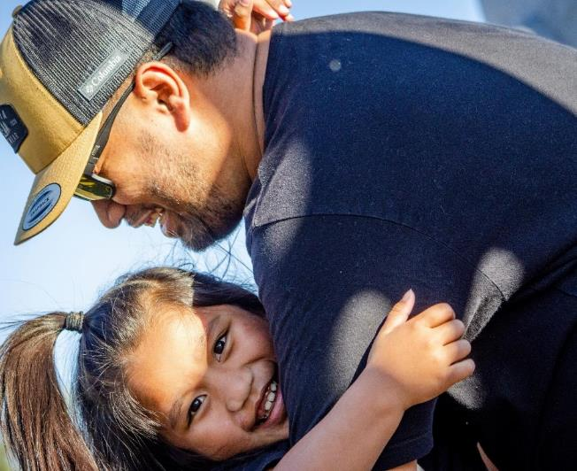
Marshallese Cultural
Health Forum
Addressing healthcare needs of the Marshallese
Sheldon Riklon, M.D.
Associate Professor
University of Arkansas for Medical Sciences
Peter O. Kohler, M.D., Endowed Chair in Health Disparities
August 30th, 2023

Slide 2
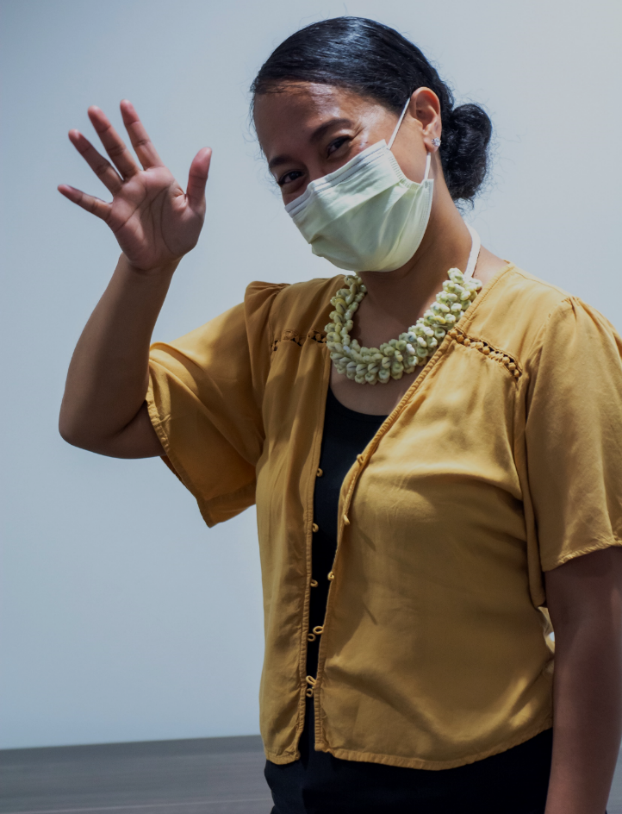
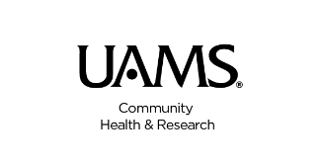
Iakwe!

Slide 3
OBJECTIVES
Define current healthcare challenges of Marshallese patients
Discuss the history of the Marshall Islands
Discuss strategies on managing chronic disease conditions
Special relationship with the United States
Understand the RMI healthcare system
Clinical practice challenges with Marshallese patients and their families
It is important to understand the history of the Marshallese as a people, and culture.

Slide 4
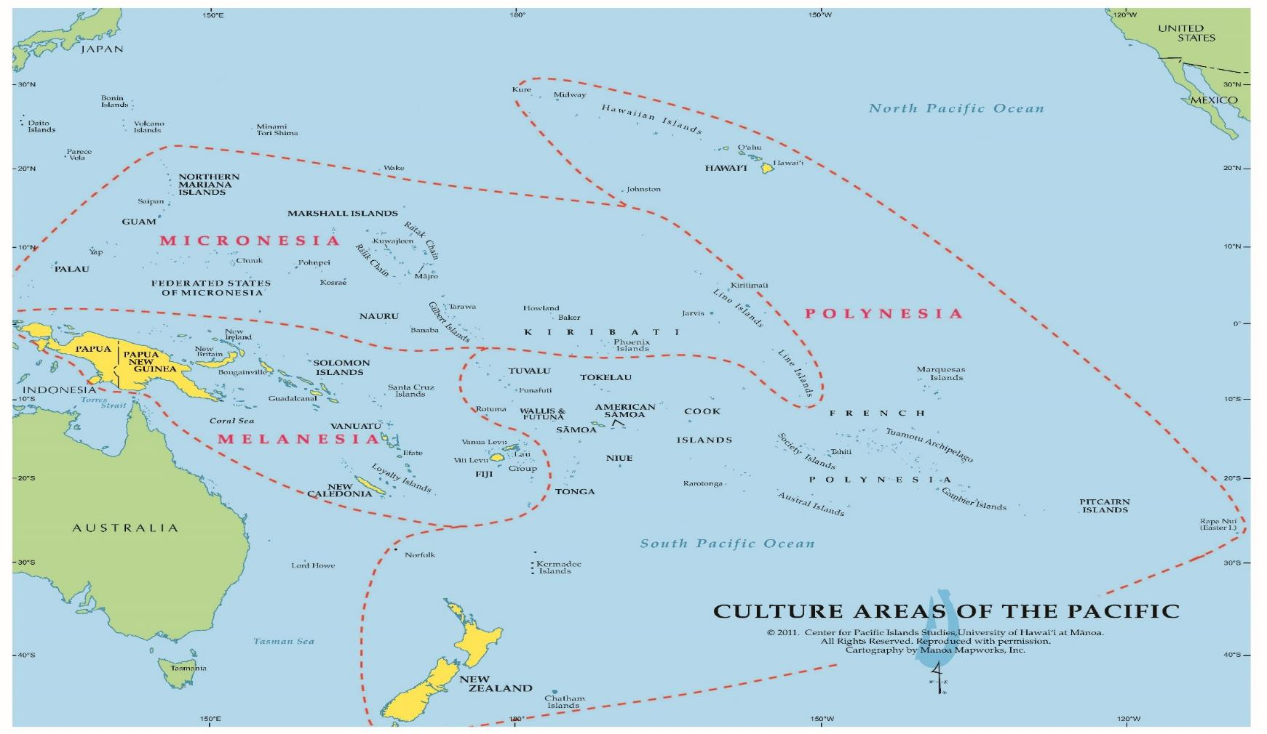
(Courtesy of the Center for Pacific Islands Studies, UH Manoa)
Notes:
Big PACIFIC Ocean --that's where we are from. That's what makes us family as PACIFIC ISLANDERS. The Ocean is what keeps up together. It's our GLUE. It's our NETWORK. It is our CONNECTION.
Polynesians include Hawaiians, Samoans, Tongans, Maori, Tahitians, Cook Islanders among others
Melanesians include Papuans, Solomon Islanders, Fijians, Vanuatu Islanders among others
Micronesians include Chamorros, Carolinians, Chuukese, Pohnpeians, Yapese, Palauans, Kosraeans and Marshallese among others

Slide 5
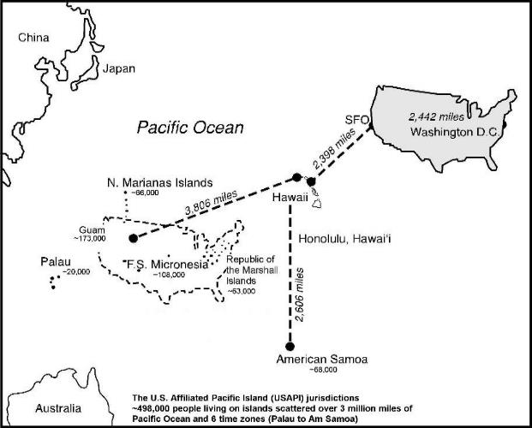
The Marshall Islands
Total area about equal to entire continental United States, but total land mass area (70 square miles) EQUAL TO SIZE of Washington, DC.

Slide 6
Republic of the Marshall Islands (RMI)
Part of Micronesia in vast Pacific Ocean
Capital: Majuro Atoll
29 Atolls and 5 coral islands
Over 750,000 sq. miles of ocean
Main Language: Marshallese
Large influence of English and Japanese
Currency: USD
Predominant religion: Christianity
Mean height: 7 feet above sea level
Climate: Hot and humid; average daily temp 81º F
About 4,712 miles to Oregon
Challenges:
Education
Nuclear weapons testing program
Climate change
Health Disparities:
Type 2 Diabetes, Hypertension, Coronary artery disease, Cancer rates, Hansen’s Disease, Tuberculosis, COVID-19

Slide 7
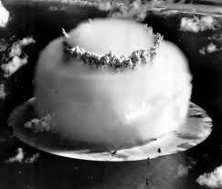
Legacy of US Nuclear Weapon Testing
The Marshall Islands were used as a nuclear test site by the United States: Testing took place from 1946-1958.
Total of 67 Atomic bombs
March 1, 1954
Bravo Shot first hydrogen bomb power 1000 Hiroshima bombs
Total yield power of 7200 Hiroshima bombs
Total yield of 108 megatons ~ 80% total yield of all US atmospheric detonations
Photo: Marshall Islands Nuclear archives

Slide 8
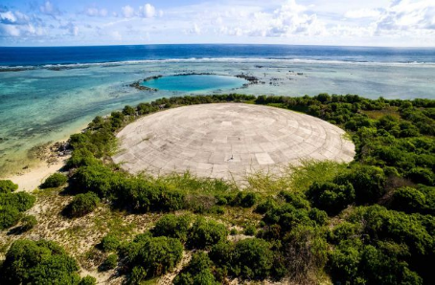
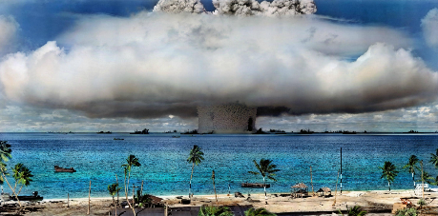
Photos: Marshall Islands Nuclear archives
Leaves large craters
Destroys fishing grounds
Contaminates land/ocean/air
Destroys traditional ways of island living, culture, family, identity
Set up for untrustworthy relationship
Right for compensation (land, health, culture)

Slide 9
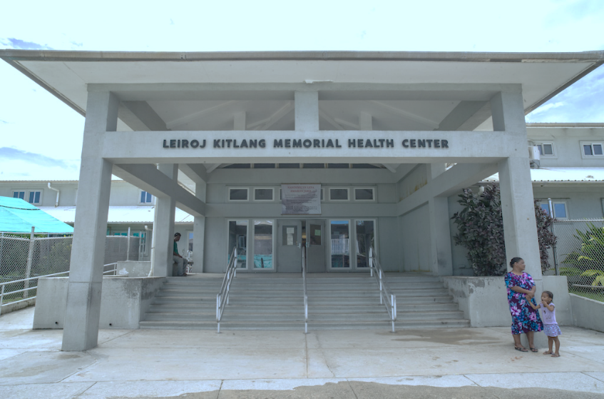
Marshall Islands Health Infrastructure
Two main public hospitals on Majuro atoll & Ebeye, Kwajalein atoll
Different healthcare systems – Ministry of Health & Human Services
Outer Islands Health Care System
Dept of Energy Special Medical Care Clinic
177/4 –atoll Health Care Program Clinic
1 Private primary clinic on Majuro
Primary care is done in the hospitals on a walk-in basis
Photo: E. Sales/ADB

Slide 10
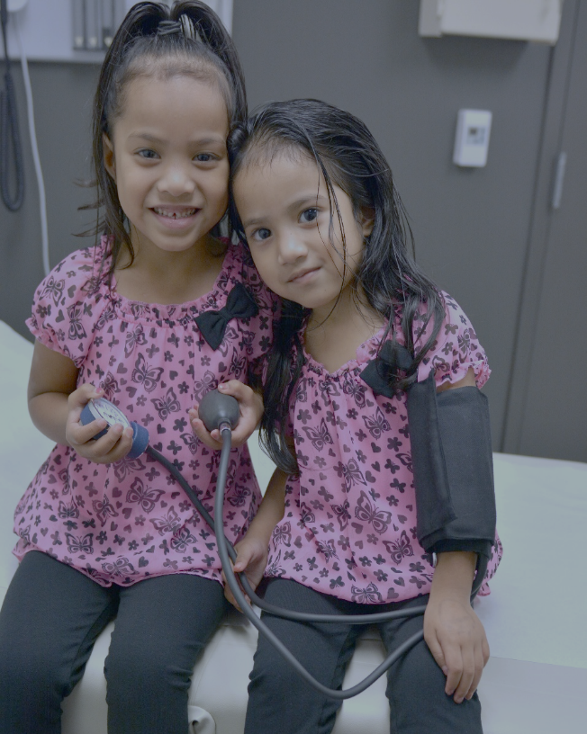
State of the RMI Health System
Limited specialist services
Primary providers: Internal medicine, Family medicine, Pediatrics, OBGYN and Nurse practitioners
Local Taiwan-trained medical doctors
Graduates of nurse practitioners
Rotation of Taiwan-based physicians/specialists
Limited health budget – No dialysis unit
Outpatient clinics (walk-ins) in the hospital
Walk-ins/ no appointments
TB clinic, DM clinic, HD clinic, Immunization clinic
Zone nurses for DOTs

Slide 11
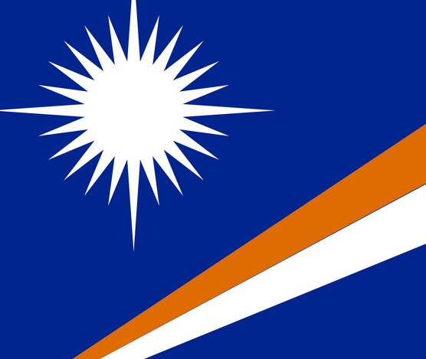
State of the RMI Health System
Health missions
(private, gov’t, NGOs)
Challenged infrastructure
Despite the many challenges, most needed healthcare is still provided
Specialty care referred off island
Not insurance based

Slide 12
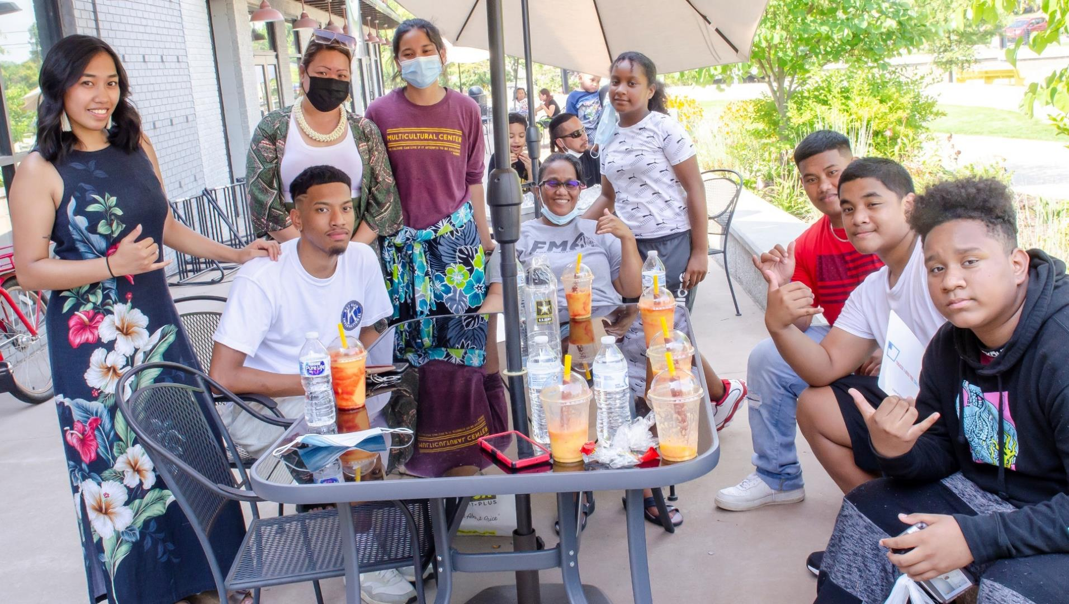
Marshallese in the US

Slide 13
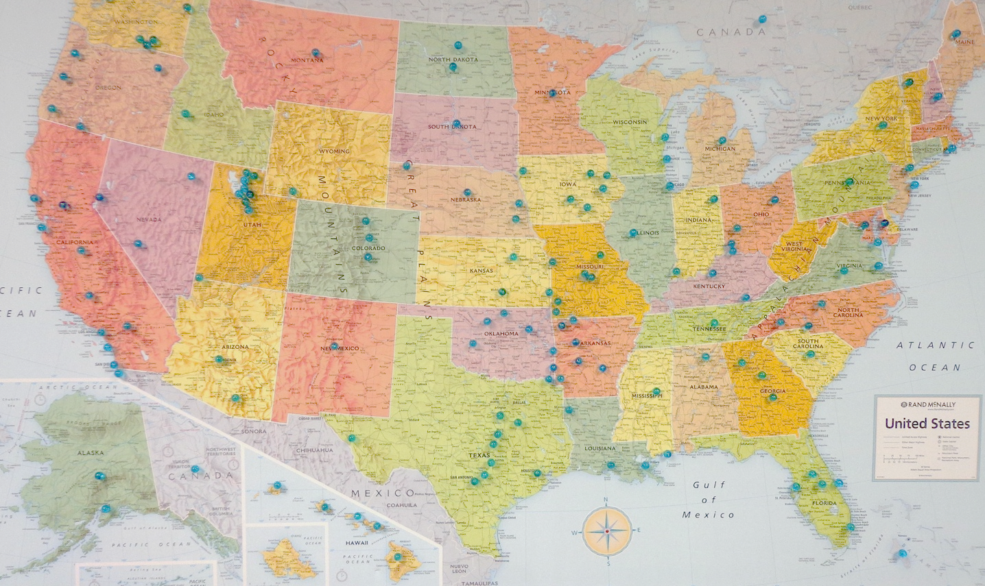
WHERE in the US are the Marshallese?

Slide 14
Pacific Islander Population Growth
Between 2000 and 2010, the Pacific Islander population in the US grew by 40%.
The fastest growth occurred in the southern US (66%), especially in Arkansas (252%).
Most of the Pacific Islanders living in Arkansas are from the Republic of the Marshall Islands.
Hixson L, Hepler B, Kim M. The Native Hawaiian and Other Pacific Islander Population: 2010. 2010 Census Briefs. Washington, DC: United States Census Bureau; 2012. https://www.census.gov/prod/cen2010/briefs/c2010br-12.pdf

Slide 15
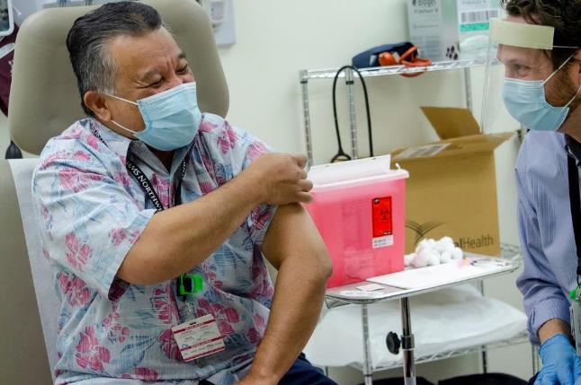
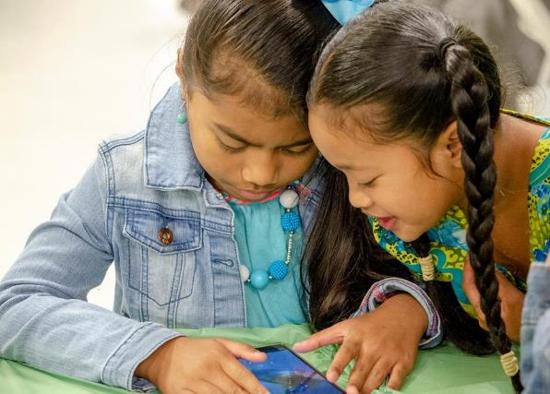
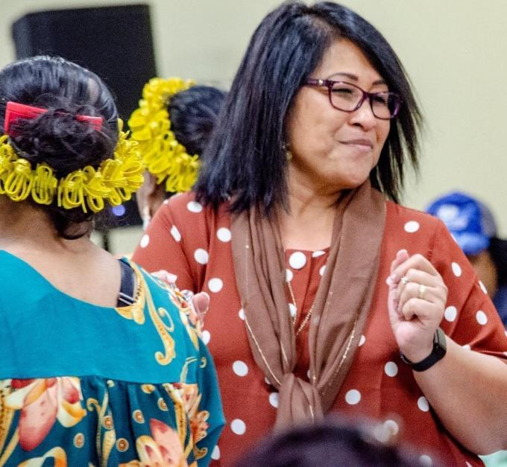
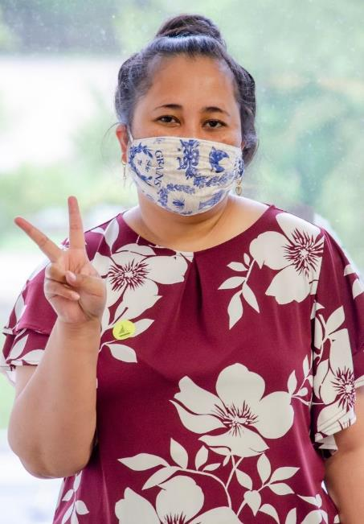
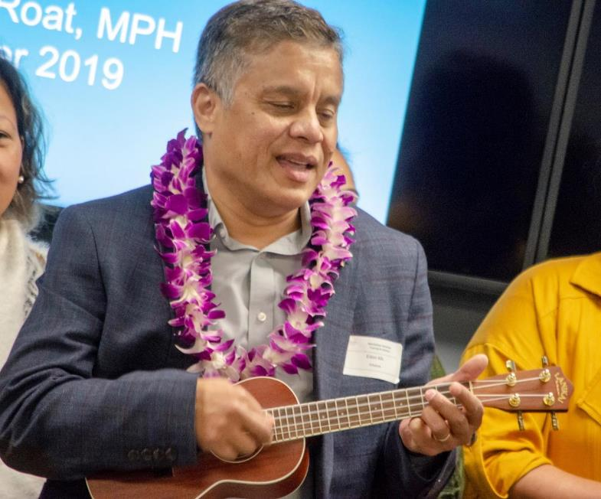
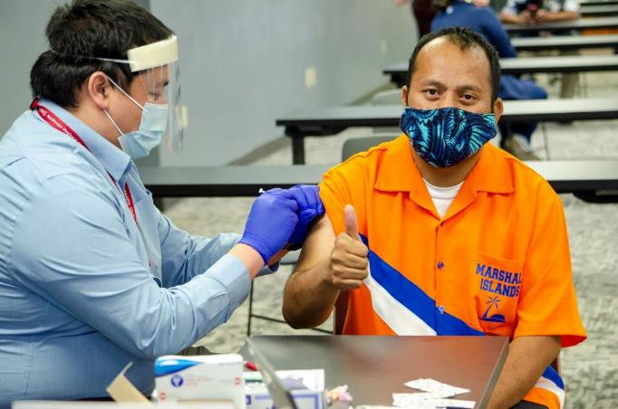
Marshallese Health

Slide 16
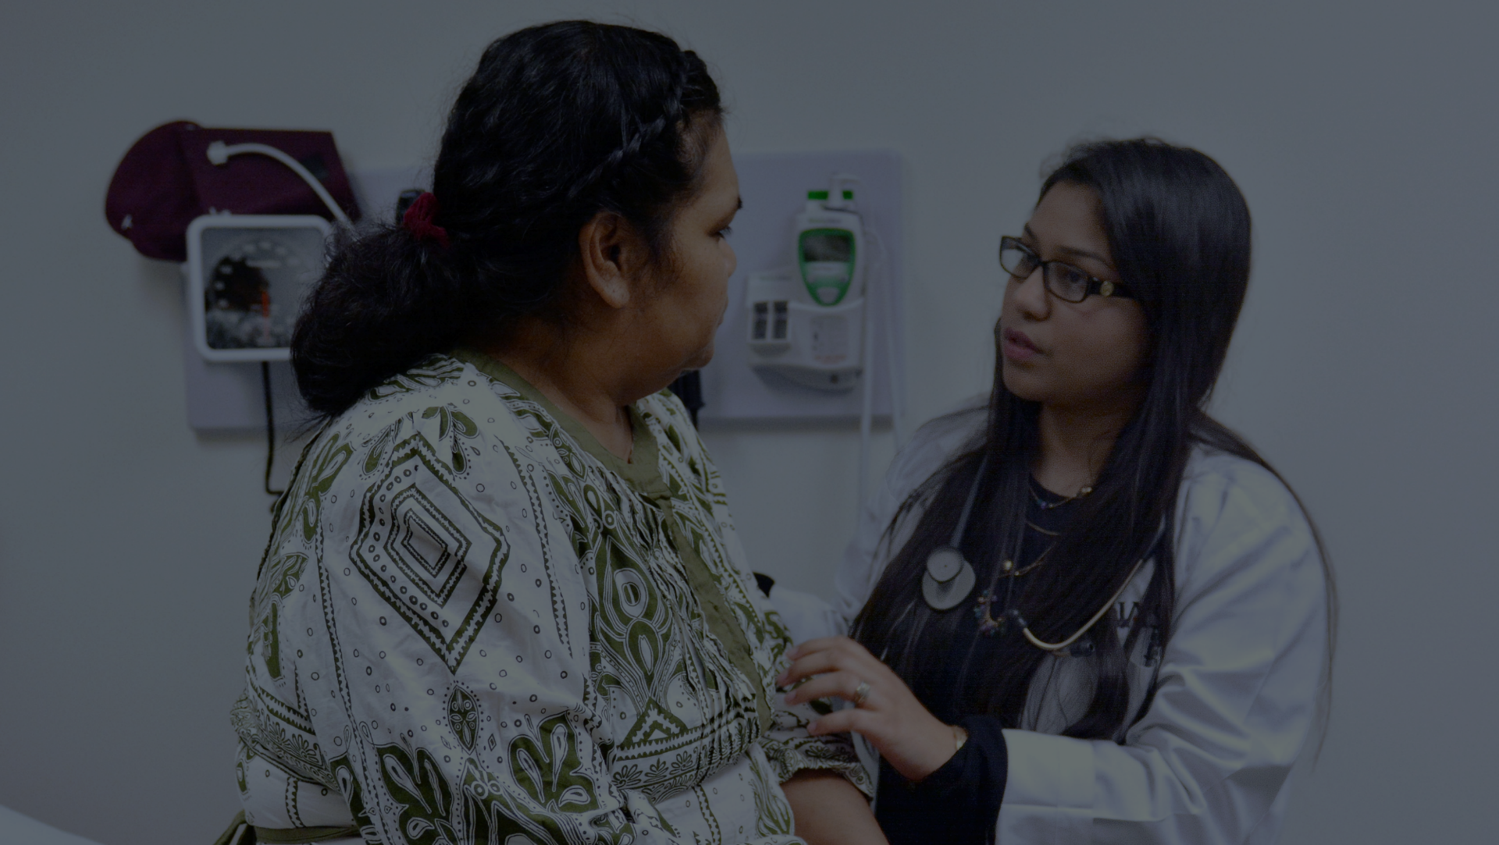
Health Disparities
in the Marshallese

Slide 17
Marshallese Health Disparities
Marshallese experience significant health disparities, with some of the highest documented prevalence and incidence of type 2 diabetes mellitus in the world.

Slide 18
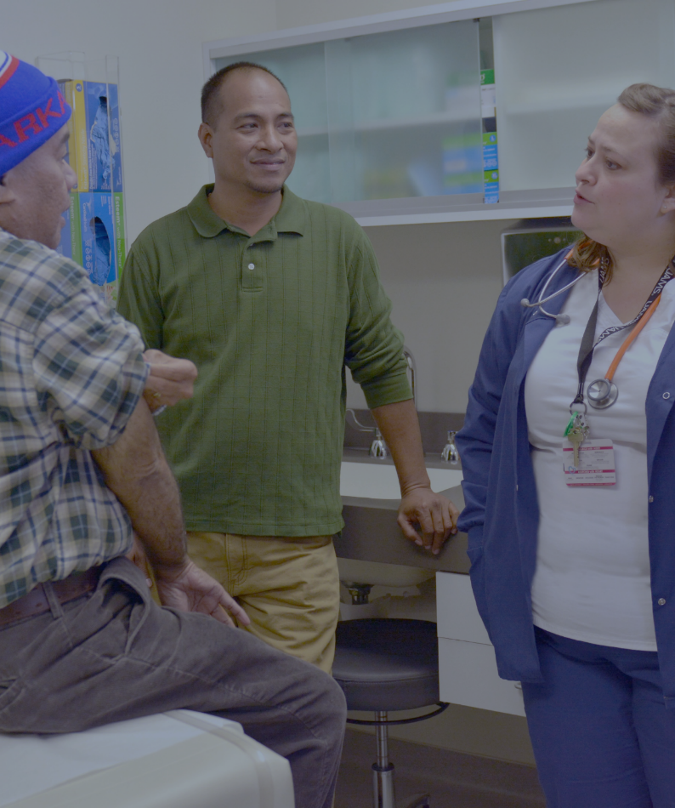
Health Indicators: Infectious Diseases
Dengue Fever
Cholera Epidemic
Syphilis Epidemic
Hepatitis B Endemic: 15 – 18% Carrier rate
Tuberculosis Endemic
Hansen’s Disease Endemic
Chikungunya
Mumps Outbreak

Slide 19
Health Outcomes - RMI
Infant Mortality: 4 – 6 x United States
Longevity (United States 78 years)
RMI – 68 years
Malnutrition and Vitamin A deficiency rates are high
Smoking/ ETOH rates high

Slide 20
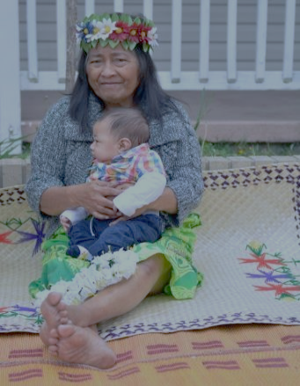
Life Expectancy
Pacific Islander | White, non-Hispanic | US total population
68.3 years | 79 years | 78.8 years
National data unavailable due to aggregation issues, but state and territory data show disparities in life expectancy.
Notes:
Although national data is unavailable due to aggregation issues, state and territory data show disparities in life expectancy. Pacific islanders are likely to die 10 years earlier than most in the U.S.

Slide 21
Health Disparities
9 HEALTH SCREENINGS BY UAMS, CONDUCTED PRIMARILY IN CHURCHES, 9/2014 – 2/2016
401 Marshallese adults screened
80.3% had hypertension or pre-hypertension
41.2% or 163 participants had hypertension (reading greater than 140/90)
39.1% or 155 participants had pre-hypertension (systolic reading of 120-139 or diastolic reading of 80-89)
Average BMI: 31.5
28% of all participants are overweight
61.7% of all participants are obese
71% had diabetes or pre-diabetes, average HbA1c: 7.2
38.4% had diabetes (HbA1c of 6.5 or higher)
76 participants had a prior diagnosis of diabetes
152 participants diagnosed with diabetes as a result of screening
32.6% had pre-diabetes (HbA1c of 5.7-6.4)
129 participants found to have pre-diabetes as a result of screening
Notes:
24-51% of surveyed Pacific Islander populations have diabetes
In comparison 8.8% of total U.S. population has diabetes
24% of Pacific Islanders surveyed by the CDC reported having diabetes in 2010. Does not take into account undiagnosed cases
CDC’s 2010 National Health Interview Survey found:
20.2% of Native Hawaiian/other Pacific Islanders had any type of heart disease
19.7% have coronary heart disease
10.6% have experienced stroke
40.8% have hypertension
In 2010, the CDC document that 44% of Pacific Islanders were obese
In Arkansas, UAMS found that out of 398 Marshallese screened:
59% obese (BMI greater than 30)
37% overweight (BMI of 25-30)
10% normal weight (BMI below 25)

Slide 22
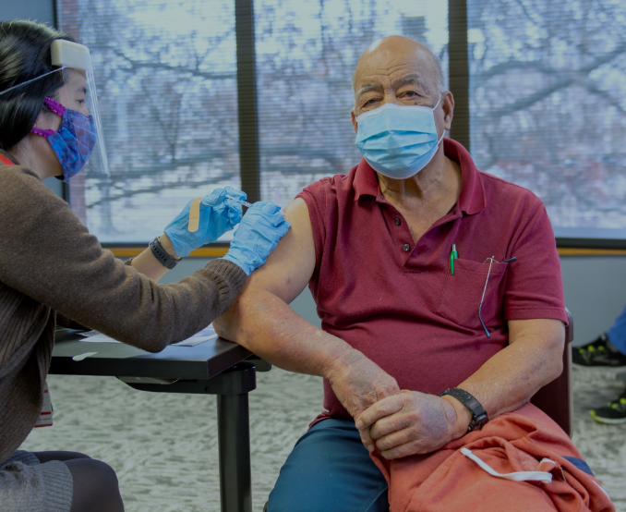
Marshallese in Northwest Arkansas
RMI is world’s 8th highest TB incidence (488/100,000 WHO 2017)
DM is a risk factor for active TB and reactivation of LTBI
DM is associated with worse TB treatment outcome
TB infection can worsen glycemic control
Drug-drug interactions complicate picture with TB/DM treatment and management
DM enhances TB progression with higher rate of relapse after TB treatment compared to non-diabetic TB patients
Need to have good communication & collaboration between providers with consistent messaging and regular follow up
Communication is key!

Slide 23
Disproportionate Impact of COVID-19 on Marshallese in NW Arkansas
July 2020: 19% of all adult cases in NWA were Pacific Islanders (primarily Marshallese) despite accounting for only 2.4% of the region’s population.
Pacific islander deaths per 100,000 in NWA were estimated to be 372.4
Much higher than overall death rate of 5.1/100K in NWA.
Pacific Islander odds of death from COVID-19 were 2.5x higher than LatinX persons

Slide 24
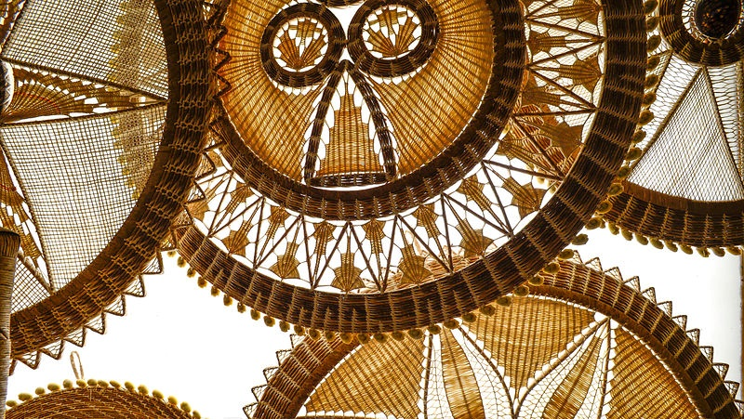
Innovative Island Approaches that worked!
Closed borders early! Marshall Islands leadership closed the borders before WHO declared COVID-19 pandemic on 3/8/2020.
Permitted the building of capacity to deal with COVID-19 (tests, vaccines, medications, HR, hospital/health capacity etc
High Vaccination Rates (“science to catch up to virus”)
House to house vaccination teams
Test-to-treat sites and mobile teams
Accessible and equitable
Free access to tests and therapeutics in the community
Targeting individuals at the greatest risk of severe disease and death
Utilizing cultural and religious leaders as ambassadors
Healthcare messaging in-language in multiple platforms

Slide 25
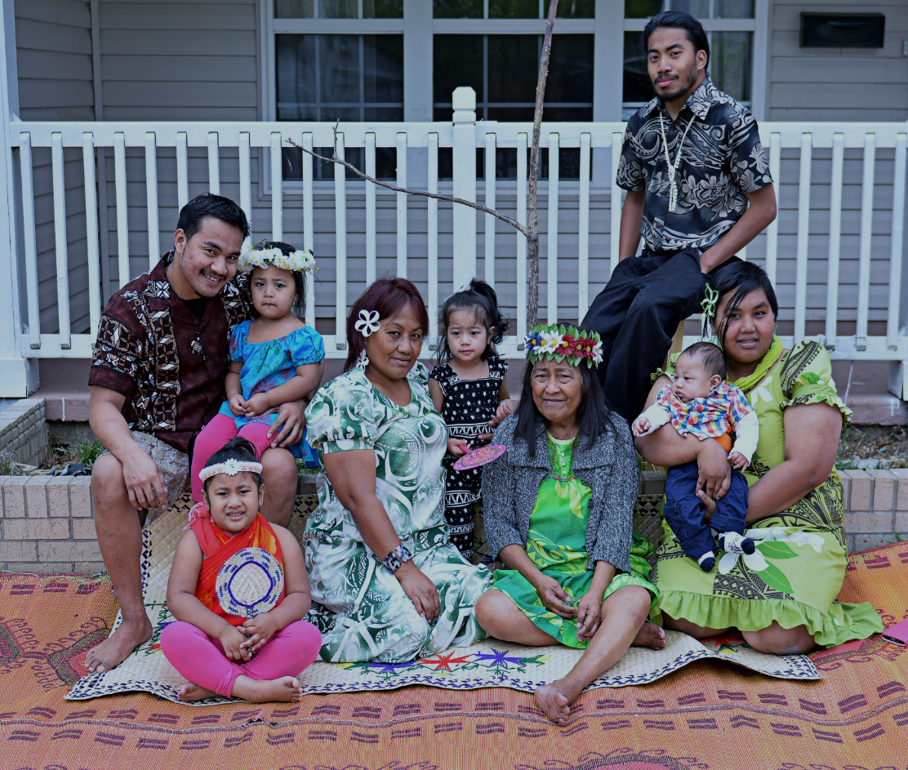
Chronic disease management in Marshallese patient populations
Understand and respect the history, distrust, culture, expectations
Understand and respect the family unit

Slide 26
Chronic disease management in Marshallese patient populations
Be visible at different settings (clinic, home, church, community events)
Hire & utilize well-trained/ certified CHWs/Navigators to build and maintain trust

Slide 27
Chronic disease management in Marshallese patient populations
Advocate for improved health care access
Regular collaboration and communication between primary care provider and other health team members

Slide 28
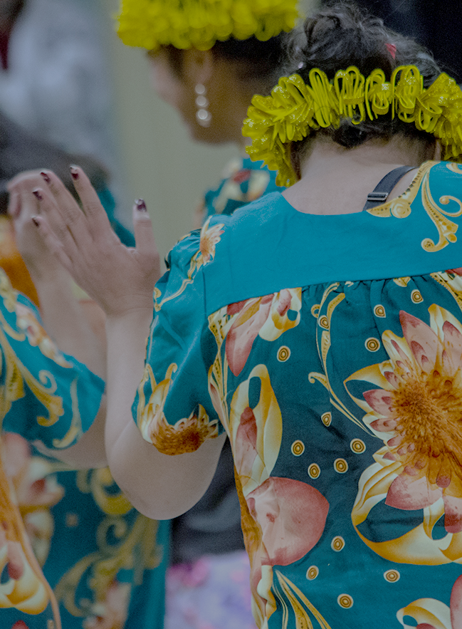
Chronic disease management in Marshallese patient populations
Consistent messaging especially in terms of relationship between infectious and chronic disease management.
Applicable to other vulnerable communities.
COMMUNICATION IS KEY!

Slide 29
Acknowledgements/Photo Credits
UAMS NW Regional Campus: Office of Community Health and Research
UAMS Center for Pacific Islander Health
Marshall Islands Nuclear Institute Archives
RMI Consulate General Office – Springdale, Arkansas
Marshall Islands Journal

Slide 30
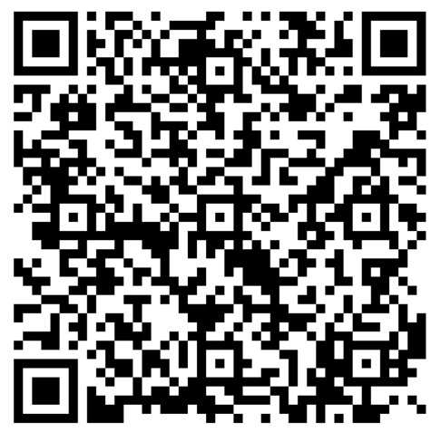
Kommol tata!
Sheldon Riklon, MD
Sriklon@uams.edu

